Slide 1
MANOVATHI J L
Final Project
3/21/2024 Annual Review

Slide 2
OBJECT DETECTION USING OPENCV
3/21/2024 Annual Review

Slide 3


AGENDA
Problem Statement
Project Overview
Who are the end users?
Solution and its values
The wow in my solution
Modelling
Results
3/21/2024 Annual Review

Slide 4
PROBLEM STATEMENT
Develop a computer vision system using OpenCV to detect objects within an image or a video stream.
The system should be capable of accurately identifying and localizing various objects of interest within the given visual data.
We can detect various objects like
Humans
Cars
Bikes
Bicycles
Bus
Animals
Machines.
3/21/2024 Annual Review

Slide 5

PROJECT OVERVIEW
The project aims to develop an automated object detection system using OpenCV, a popular open-source computer vision library.
Object detection is a fundamental task in computer vision, with applications ranging from surveillance and security to autonomous vehicles and augmented reality.
By leveraging OpenCV's extensive capabilities, the system will be capable of detecting and localizing various objects within images or video streams in real-time or near real-time.
Ensure the system's efficiency by optimizing algorithms and leveraging parallel processing for real-time performance.
3/21/2024 Annual Review

Slide 6

WHO ARE THE END USERS?
Industry Security and Surveilliance process Educational and Academic Institutions Smart city plans Urban developers Medical Professionals Retail and Marketing Analysts Automobile industries.
3/21/2024 Annual Review

Slide 7

YOUR SOLUTION AND ITS VALUE PROPOSITION
Improved Efficiency: By automating object detection tasks, our solution saves time and resources for users across various industries. Whether it's monitoring security cameras, analyzing retail foot traffic, or inspecting manufacturing lines, our system streamlines operations and enhances efficiency.
Enhanced Safety and Security: In applications such as surveillance and security, our system helps detect and respond to potential threats promptly, improving safety and security for individuals and assets
Cost-effectiveness: Our open-source approach and use of readily available tools like OpenCV minimize the cost of implementation and maintenance for users, making advanced object detection capabilities accessible to organizations of all sizes.
3/21/2024 Annual Review

Slide 8

THE WOW IN YOUR SOLUTION
Real time implementation
Higher Performance
Scalability
Flexibility
Easy to implement and use
User friendly
High accuracy
3/21/2024 Annual Review
8

Slide 9
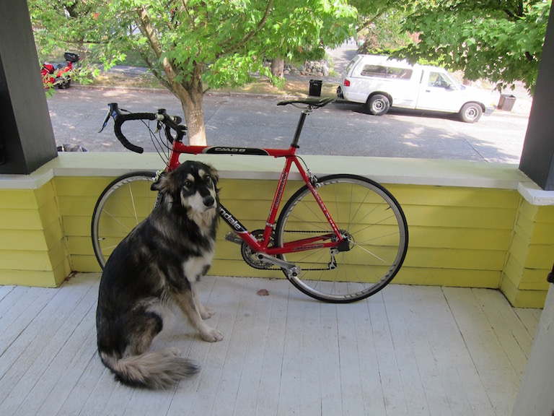
MODELLING
Modeling for Object Detection Using OpenCV typically involves several steps, including data collection, preprocessing, model selection, training, evaluation, and deployment.
Here is the model for object detection:
3/21/2024 Annual Review
9

Slide 10
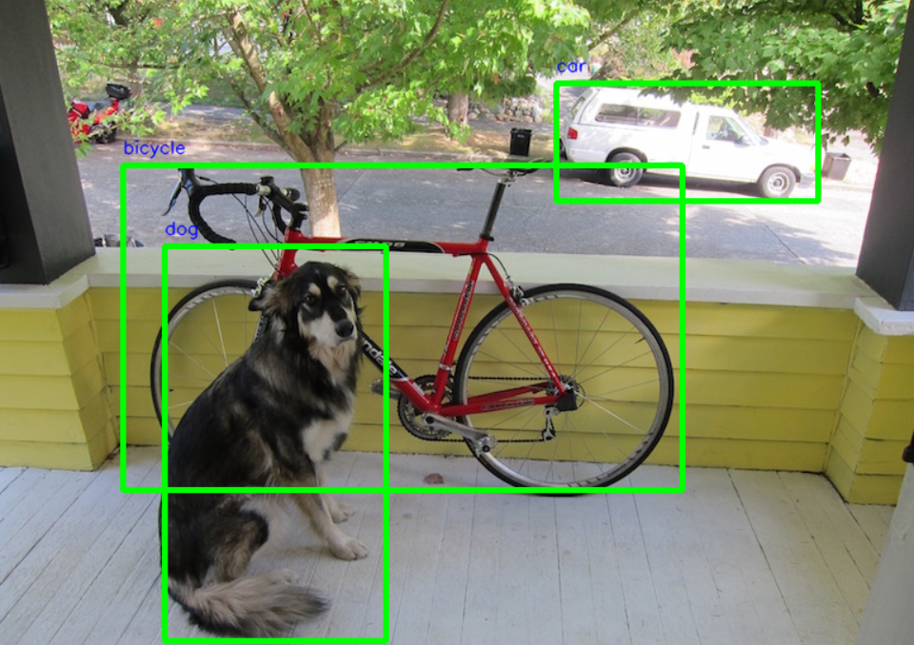
RESULTS
Demo Link
3/21/2024 Annual Review
10

